Slide 2
How to use this book: Story Time
If the title of the book is Story Time, what do you think this book will be about?
The following pictures show some of the stories in this book.
Teachers and parents may want to ask the children who and what they see in the pictures, and what they think the stories will be about.

Slide 3
Page 5.

Slide 4
Page 15.

Slide 5
Page 19.

Slide 6
Page 22.

Slide 7
Page 25.

Slide 8
Page 27.

Slide 9
Page 31

Slide 10
Page 31

Slide 11
Page 47

Slide 12
Page 31

Slide 13
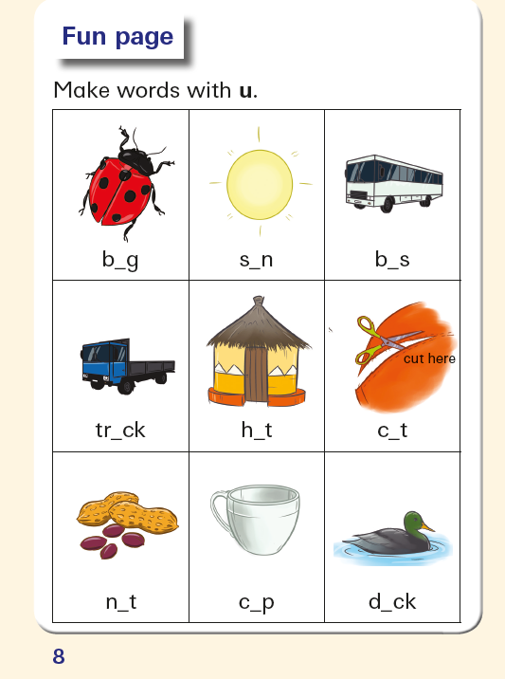
Sunrise Readers Book 4 Story Time
Page 8 Work Sheet

Slide 16
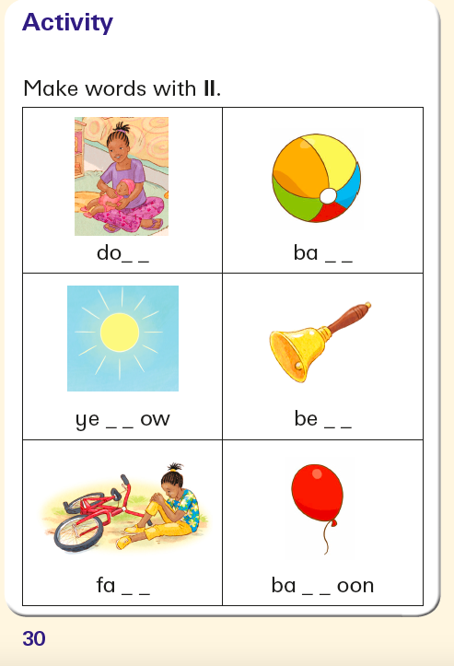
Sunrise Readers Book 4 Story Time Page 30 Work Sheet

Slide 18
Page 52
Fun on a rainy day!

Slide 19
Page 53

Slide 20
Animals: Can you say the animal’s names?
Page 54

