Slide 1
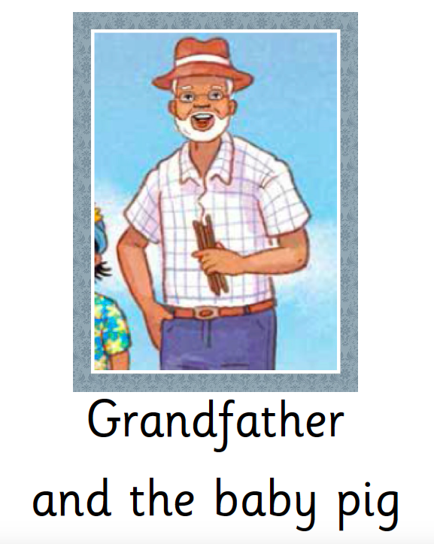

Slide 2
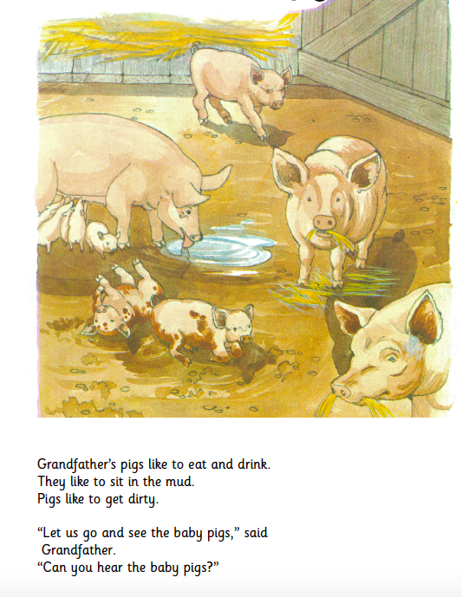
Grandfather’s pigs like to eat and drink.
They like to sit in the mud.
Pigs like to get dirty.
“Let us go and see the baby pigs,” said Grandfather.
“Can you hear the baby pigs?”

Slide 3
One baby pig was hurt.
Grandfather wanted to see the hurt baby pig.
“Catch him for me,” he said.
The two boys ran to catch the hurt pig.
The baby pig ran away fast.
“We cannot catch him,” said David.

Slide 4
“He is too fast for us!”
The hurt pig ran to Grandfather.
“Catch him, Grandfather!” said Tatenda.
The baby pig ran into Grandfather.
Grandfather fell down in the mud.

Slide 5
“Oh Grandfather! Are you hurt?” said Tatenda.
“No,” said Grandfather.
“I am not hurt.
I am dirty.
Do I look funny?”
“Oh yes,” said Tatenda.
“You do look funny.
Let me help you up.”

Slide 6
Grandfather helped the baby pig.
“The baby pig is happy,” said Grandfather.
“Let us go to Grandmother.
I am muddy.
I must wash the mud off.”
“Oh, Grandfather!” said Grandmother.
“You are so dirty!”

Slide 7
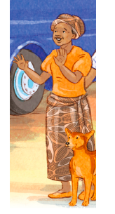
“You boys are dirty too,” said Grandmother.
“Go and wash. It is time to eat.”
“You boys look funny,”
said Chipo.
“You are so dirty!
Funny Grandfather!
Funny boys!”

Slide 8
“Yes,” said Grandfather.
“I fell in the mud.
The boys helped me catch the baby pig.
The baby pig is not hurt now.
Let us wash, boys.
Thank you for helping me.”

Slide 9
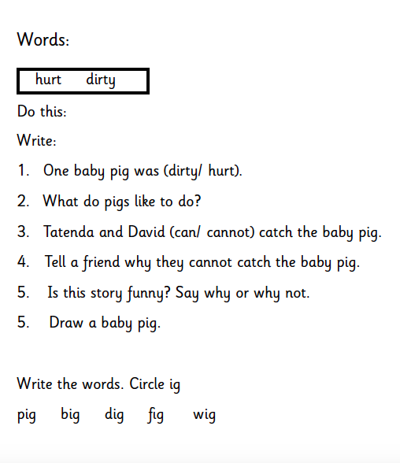

Slide 10
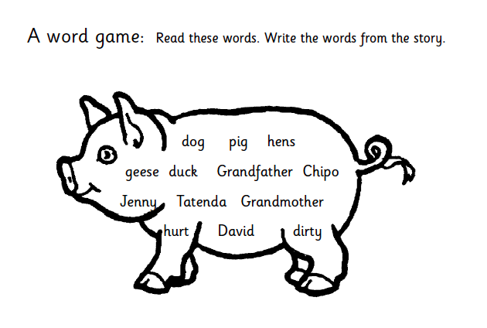

Slide 11
