Slide 1
Sunrise Readers
Book Six

Slide 2
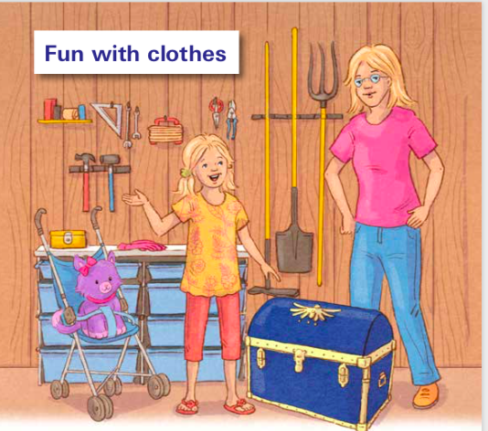
Fun with clothes – talk about:

Slide 3
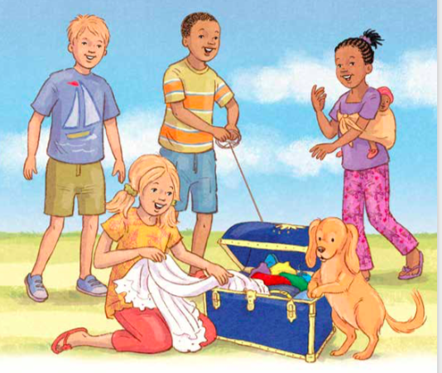

Slide 4
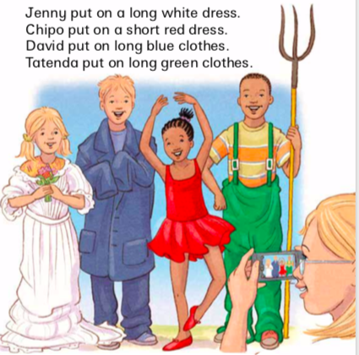

Slide 5
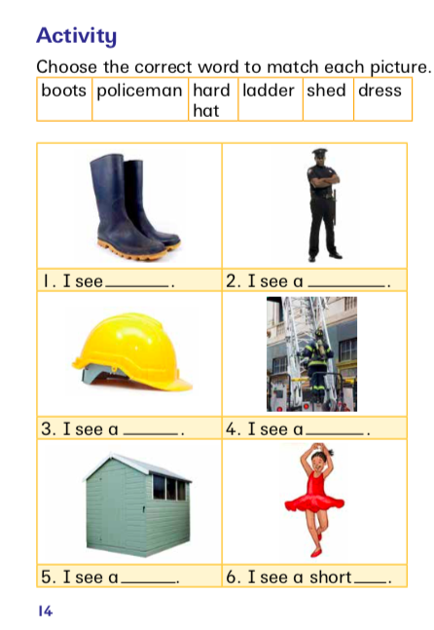

Slide 7
