Slide 1


Slide 3
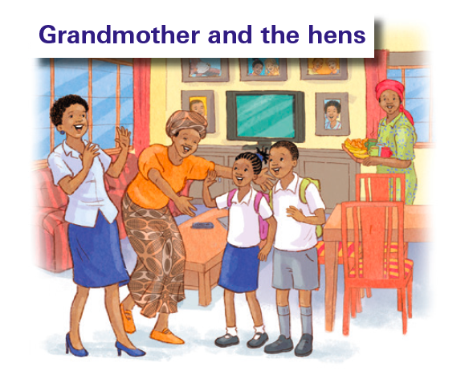

Slide 4
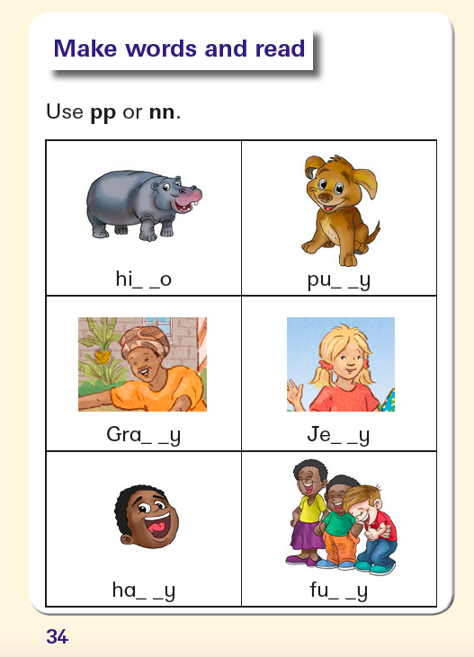

Slide 5
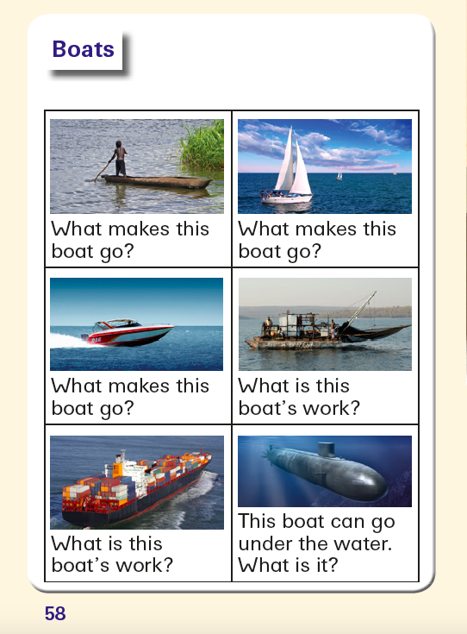

Slide 6
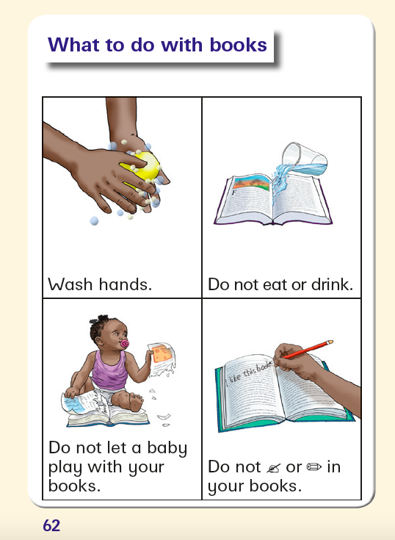

Slide 7
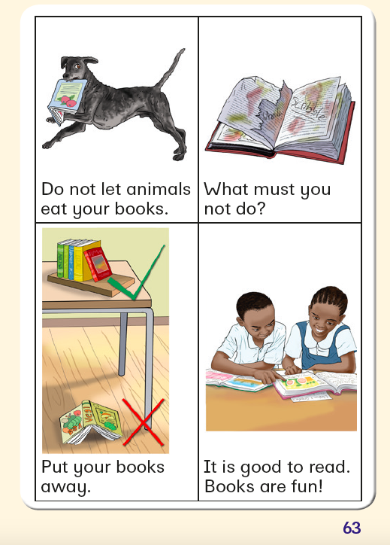

Slide 8
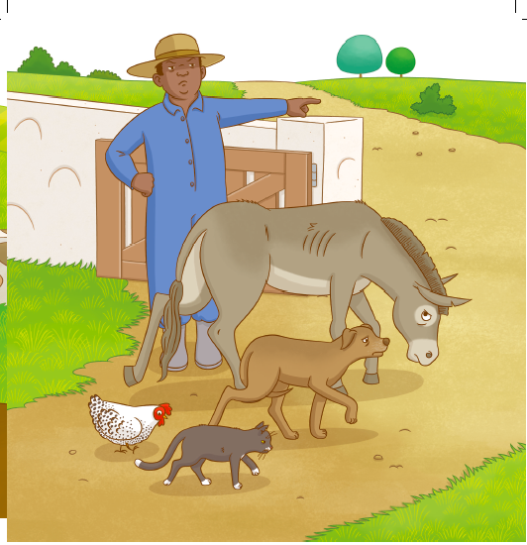
Let us talk ...

Slide 9
Feelings/ Emotions
Words for learners, teachers and parents to think about:
Give lots of praise for the learners’ efforts to use and identify words that correctly express the emotions in these story pictures.
Be encouraging. Make the most of every answer – children may observe how they would feel in this situation, rather than what they see in the picture.)
The learners cannot recognise or read these words, but they may be part of their spoken vocabulary.
Other words than these may be used:
sad happy angry cross afraid frightened guilty (‘bad’)

Slide 10
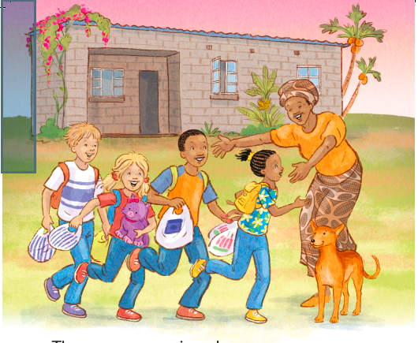

Slide 11
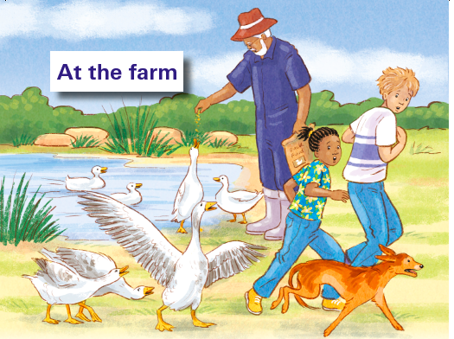

Slide 12
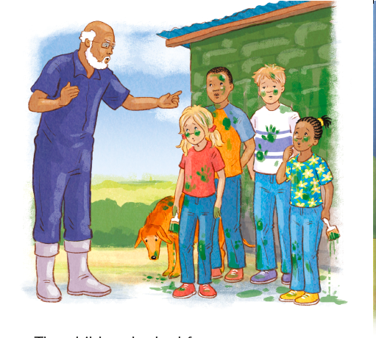

Slide 13


Slide 14
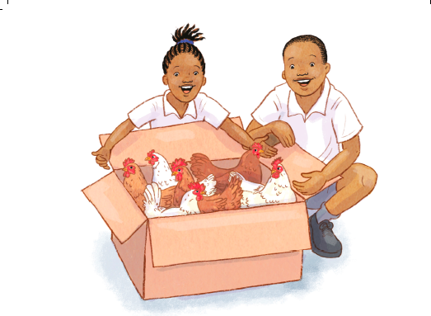

Slide 15
Tell the story...
Look at these ‘busy’ pictures and talk about what’s happening. Teachers/ parents/ children ask questions such as (e.g. Page 19 Fun day at school).
Q: What is happening in this picture?
Where are they? How do you know this?
What kind of day is it?
Who is in the picture?
What are they doing?
Why are they doing this?
Would you like to do this? Why?
What might happen next?

Slide 16
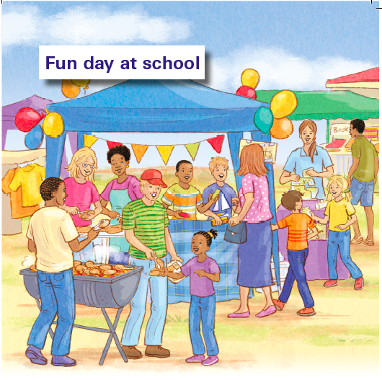

Slide 17
