Slide 1
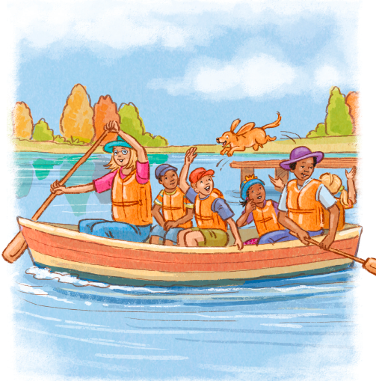
The Sunrise Family

Slide 2
Here is Mother.

Slide 3
Here is Grandmother.

Slide 4
Here is Father.

Slide 5
We like to work.

Slide 6
Here is Mother.

Slide 7
Help Mother work.

Slide 8
Here is Uncle Tim.

Slide 9
See Uncle Tim help.

Slide 10
Here is Aunt Pat.

